Slide 1
Chapter 14 – Graphical User Components Part 2
Outline
14.1 Introduction
14.2 JTextArea
14.3 Creating a Customized Subclass of JPanel
14.4 JPanel Subclass that Handles Its Own Events
14.5 JSlider
14.6 Windows: Additional Notes
14.7 Using Menus with Frames
14.8 JPopupMenu
14.9 Pluggable Look-and-Feel
14.10 JDesktopPane and JInternalFrame
14.11 JTabbedPane
14.12 Layout Managers: BoxLayout and GridBagLayout
14.13 (Optional Case Study) Thinking About Objects: Model-View- Controller

Slide 2
Chapter 14 – Graphical User Components Part 2
14.14 (Optional) Discovering Design Patterns: Design Patterns Used in Packages java.awt and javax.swing
14.14.1 Creational Design Patterns
14.14.2 Structural Design Patterns
14.14.3 Behavioral Design Patterns
14.14.4 Conclusion

Slide 3
14.1 Introduction
Advanced GUI components
  Text areas
  Sliders
  Menus
Multiple Document Interface (MDI)
Advanced layout managers
  BoxLayout
  GridBagLayout

Slide 4
14.2 JTextArea
JTextArea
  Area for manipulating multiple lines of text
  extends JTextComponent

Slide 5
TextAreaDemo.java
Line 16
Lines 18-24
1 // Fig. 14.1: TextAreaDemo.java
2 // Copying selected text from one textarea to another.
3 import java.awt.*;
4 import java.awt.event.*;
5 import javax.swing.*;
6
7 public class TextAreaDemo extends JFrame {
8 private JTextArea textArea1, textArea2;
9 private JButton copyButton;
10
11 // set up GUI
12 public TextAreaDemo()
13 {
14 super( "TextArea Demo" );
15
16 Box box = Box.createHorizontalBox();
17
18 String string = "This is a demo string to\n" +
19 "illustrate copying text\nfrom one textarea to \n" +
20 "another textarea using an\nexternal event\n";
21
22 // set up textArea1
23 textArea1 = new JTextArea( string, 10, 15 );
24 box.add( new JScrollPane( textArea1 ) );
25
Create Box container for organizing GUI components
Populate JTextArea with String, then add to Box

Slide 6
TextAreaDemo.java
Line 36
Lines 44-45
26 // set up copyButton
27 copyButton = new JButton( "Copy >>>" );
28 box.add( copyButton );
29 copyButton.addActionListener(
30
31 new ActionListener() { // anonymous inner class
32
33 // set text in textArea2 to selected text from textArea1
34 public void actionPerformed( ActionEvent event )
35 {
36 textArea2.setText( textArea1.getSelectedText() );
37 }
38
39 } // end anonymous inner class
40
41 ); // end call to addActionListener
42
43 // set up textArea2
44 textArea2 = new JTextArea( 10, 15 );
45 textArea2.setEditable( false );
46 box.add( new JScrollPane( textArea2 ) );
47
48 // add box to content pane
49 Container container = getContentPane();
50 container.add( box ); // place in BorderLayout.CENTER
51
When user presses JButton, textArea1’s highlighted text is copied into textArea2
Instantiate uneditable JTextArea

Slide 7
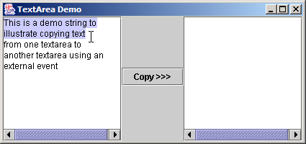
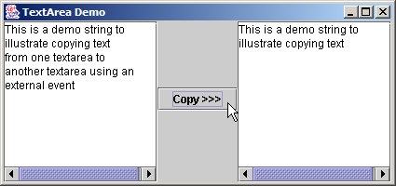
TextAreaDemo.java
52 setSize( 425, 200 );
53 setVisible( true );
54
55 } // end constructor TextAreaDemo
56
57 public static void main( String args[] )
58 {
59 TextAreaDemo application = new TextAreaDemo();
60 application.setDefaultCloseOperation( JFrame.EXIT_ON_CLOSE );
61 }
62
63 } // end class TextAreaDemo

Slide 8
14.3 Creating a Customized Subclass of JPanel
Extend JPanel to create new components
  Dedicated drawing area
    Method paintComponent of class JComponent

Slide 9
CustomPanel.java
Line 8
Line 11
Line 25
1 // Fig. 14.2: CustomPanel.java
2 // A customized JPanel class.
3 import java.awt.*;
4 import javax.swing.*;
5
6 public class CustomPanel extends JPanel {
7 public final static int CIRCLE = 1, SQUARE = 2;
8 private int shape;
9
10 // use shape to draw an oval or rectangle
11 public void paintComponent( Graphics g )
12 {
13 super.paintComponent( g );
14
15 if ( shape == CIRCLE )
16 g.fillOval( 50, 10, 60, 60 );
17 else if ( shape == SQUARE )
18 g.fillRect( 50, 10, 60, 60 );
19 }
20
21 // set shape value and repaint CustomPanel
22 public void draw( int shapeToDraw )
23 {
24 shape = shapeToDraw;
25 repaint();
}
27
28 } // end class CustomPanel
Store integer representing shape to draw
Override method paintComponent of class JComponent to draw oval or rectangle
Method repaint calls method paintComponent

Slide 10
CustomPanelTest.java
Lines 18-19
1 // Fig. 14.3: CustomPanelTest.java
2 // Using a customized Panel object.
3 import java.awt.*;
4 import java.awt.event.*;
5 import javax.swing.*;
6
7 public class CustomPanelTest extends JFrame {
8 private JPanel buttonPanel;
9 private CustomPanel myPanel;
10 private JButton circleButton, squareButton;
11
12 // set up GUI
13 public CustomPanelTest()
14 {
15 super( "CustomPanel Test" );
16
17 // create custom drawing area
18 myPanel = new CustomPanel();
19 myPanel.setBackground( Color.GREEN );
20
21 // set up squareButton
22 squareButton = new JButton( "Square" );
23 squareButton.addActionListener(
24
Instantiate CustomPanel object and set background to green

Slide 11
CustomPanelTest.java
Line 30
Line 45
25 new ActionListener() { // anonymous inner class
26
27 // draw a square
28 public void actionPerformed( ActionEvent event )
29 {
30 myPanel.draw( CustomPanel.SQUARE );
31 }
32
33 } // end anonymous inner class
34
35 ); // end call to addActionListener
36
37 circleButton = new JButton( "Circle" );
38 circleButton.addActionListener(
39
40 new ActionListener() { // anonymous inner class
41
42 // draw a circle
43 public void actionPerformed( ActionEvent event )
44 {
45 myPanel.draw( CustomPanel.CIRCLE );
46 }
47
48 } // end anonymous inner class
49
50 ); // end call to addActionListener
51
When user presses squareButton, draw square on CustomPanel
When user presses circleButton, draw circle on CustomPanel

Slide 12
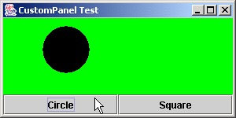
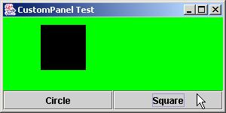
CustomPanelTest.java
Line 54
52 // set up panel containing buttons
53 buttonPanel = new JPanel();
54 buttonPanel.setLayout( new GridLayout( 1, 2 ) );
55 buttonPanel.add( circleButton );
56 buttonPanel.add( squareButton );
57
58 // attach button panel & custom drawing area to content pane
59 Container container = getContentPane();
60 container.add( myPanel, BorderLayout.CENTER );
61 container.add( buttonPanel, BorderLayout.SOUTH );
62
63 setSize( 300, 150 );
64 setVisible( true );
65
66 } // end constructor CustomPanelTest
67
68 public static void main( String args[] )
69 {
70 CustomPanelTest application = new CustomPanelTest();
71 application.setDefaultCloseOperation( JFrame.EXIT_ON_CLOSE );
72 }
73
74 } // end class CustomPanelTest
Use GridLayout to organize buttons

Slide 13
14.4 JPanel Subclass that Handles Its Own Events
JPanel
  Does not support conventional events
    e.g., events offered by buttons, text areas, etc.
  Capable of recognizing lower-level events
    e.g., mouse events, key events, etc.
  Self-contained panel
    Listens for its own mouse events

Slide 14
SelfContainedPanel.java
Line 16
Lines 23-24
1 // Fig. 14.4: SelfContainedPanel.java
2 // A self-contained JPanel class that handles its own mouse events.
3 package com.deitel.jhtp5.ch14;
4
5 import java.awt.*;
6 import java.awt.event.*;
7 import javax.swing.*;
8
9 public class SelfContainedPanel extends JPanel {
10 private int x1, y1, x2, y2;
11
12 // set up mouse event handling for SelfContainedPanel
13 public SelfContainedPanel()
14 {
15 // set up mouse listener
16 addMouseListener(
17
18 new MouseAdapter() { // anonymous inner class
19
20 // handle mouse press event
21 public void mousePressed( MouseEvent event )
22 {
23 x1 = event.getX();
24 y1 = event.getY();
25 }
26
Self-contained JPanel listens for MouseEvents
Save coordinates where user pressed mouse button

Slide 15
SelfContainedPanel.java
Lines 30-31
Line 40
Lines 47-48
27 // handle mouse release event
28 public void mouseReleased( MouseEvent event )
29 {
30 x2 = event.getX();
31 y2 = event.getY();
32 repaint();
33 }
34
35 } // end anonymous inner class
36
37 ); // end call to addMouseListener
38
39 // set up mouse motion listener
40 addMouseMotionListener(
41
42 new MouseMotionAdapter() { // anonymous inner class
43
44 // handle mouse drag event
45 public void mouseDragged( MouseEvent event )
46 {
47 x2 = event.getX();
48 y2 = event.getY();
49 repaint();
50 }
51
Save coordinates where user released mouse button, then repaint
Self-contained JPanel listens for when mouse moves
Save coordinates where user dragged mouse, then repaint

Slide 16
SelfContainedPanel.java
Lines 69-70
52 } // end anonymous inner class
53
54 ); // end call to addMouseMotionListener
55
56 } // end constructor SelfContainedPanel
57
58 // return preferred width and height of SelfContainedPanel
59 public Dimension getPreferredSize()
60 {
61 return new Dimension( 150, 100 );
62 }
63
64 // paint an oval at the specified coordinates
65 public void paintComponent( Graphics g )
66 {
67 super.paintComponent( g );
68
69 g.drawOval( Math.min( x1, x2 ), Math.min( y1, y2 ),
70 Math.abs( x1 - x2 ), Math.abs( y1 - y2 ) );
71 }
72
73 } // end class SelfContainedPanel
Draw oval

Slide 17
SelfContainedPanelTest.java
Lines 17-18
1 // Fig. 14.5: SelfContainedPanelTest.java
2 // Creating a self-contained subclass of JPanel that processes
3 // its own mouse events.
4 import java.awt.*;
5 import java.awt.event.*;
6 import javax.swing.*;
7
8 import com.deitel.jhtp5.ch14.SelfContainedPanel;
9
10 public class SelfContainedPanelTest extends JFrame {
11 private SelfContainedPanel myPanel;
12
13 // set up GUI and mouse motion event handlers for application window
14 public SelfContainedPanelTest()
15 {
16 // set up a SelfContainedPanel
17 myPanel = new SelfContainedPanel();
18 myPanel.setBackground( Color.YELLOW );
19
20 Container container = getContentPane();
21 container.setLayout( new FlowLayout() );
22 container.add( myPanel );
23
Instantiate SelfContaintedPanel object and set background to yellow

Slide 18
SelfContainedPanelTest.java
Line 25
Lines 30-41
24 // set up mouse motion event handling
25 addMouseMotionListener(
26
27 new MouseMotionListener() { // anonymous inner class
28
29 // handle mouse drag event
30 public void mouseDragged( MouseEvent event )
31 {
32 setTitle( "Dragging: x=" + event.getX() +
33 "; y=" + event.getY() );
34 }
35
36 // handle mouse move event
37 public void mouseMoved( MouseEvent event )
38 {
39 setTitle( "Moving: x=" + event.getX() +
40 "; y=" + event.getY() );
41 }
42
43 } // end anonymous inner class
44
45 ); // end call to addMouseMotionListener
46
47 setSize( 300, 200 );
48 setVisible( true );
49
50 } // end constructor SelfContainedPanelTest
Register anonymous-inner-class object to handle mouse motion events
Display String in title bar indicating x-y coordinate where mouse-motion event occurred

Slide 19
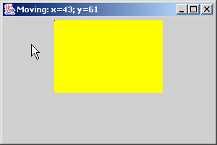
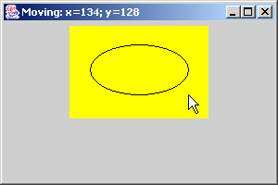
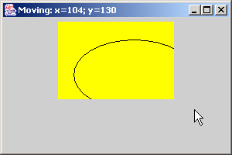
SelfContainedPanelTest.java
51
52 public static void main( String args[] )
53 {
54 SelfContainedPanelTest application = new SelfContainedPanelTest();
55 application.setDefaultCloseOperation( JFrame.EXIT_ON_CLOSE );
56 }
57
58 } // end class SelfContainedPanelTest

Slide 20
14.5 JSlider
JSlider
  Enable users to select from range of integer values
  Several features
    Tick marks (major and minor)
    Snap-to ticks
    Orientation (horizontal and vertical)

Slide 21
Fig. 14.6 JSlider component with horizontal orientation
thumb
tick mark

Slide 22
OvalPanel.java
Line 14
Line 18
1 // Fig. 14.7: OvalPanel.java
2 // A customized JPanel class.
3 import java.awt.*;
4 import javax.swing.*;
5
6 public class OvalPanel extends JPanel {
7 private int diameter = 10;
8
9 // draw an oval of the specified diameter
10 public void paintComponent( Graphics g )
11 {
12 super.paintComponent( g );
13
14 g.fillOval( 10, 10, diameter, diameter );
15 }
16
17 // validate and set diameter, then repaint
18 public void setDiameter( int newDiameter )
19 {
20 // if diameter invalid, default to 10
21 diameter = ( newDiameter >= 0 ? newDiameter : 10 );
22 repaint();
23 }
24
Draw filled oval of diameter
Set diameter, then repaint

Slide 23
OvalPanel.java
25 // used by layout manager to determine preferred size
26 public Dimension getPreferredSize()
27 {
28 return new Dimension( 200, 200 );
29 }
30
31 // used by layout manager to determine minimum size
32 public Dimension getMinimumSize()
33 {
34 return getPreferredSize();
35 }
36
37 } // end class OvalPanel

Slide 24
SliderDemo.java
Lines 18-19
Lines 22-23
1 // Fig. 14.8: SliderDemo.java
2 // Using JSliders to size an oval.
3 import java.awt.*;
4 import java.awt.event.*;
5 import javax.swing.*;
6 import javax.swing.event.*;
7
8 public class SliderDemo extends JFrame {
9 private JSlider diameterSlider;
10 private OvalPanel myPanel;
11
12 // set up GUI
13 public SliderDemo()
14 {
15 super( "Slider Demo" );
16
17 // set up OvalPanel
18 myPanel = new OvalPanel();
19 myPanel.setBackground( Color.YELLOW );
20
21 // set up JSlider to control diameter value
22 diameterSlider =
23 new JSlider( SwingConstants.HORIZONTAL, 0, 200, 10 );
24 diameterSlider.setMajorTickSpacing( 10 );
25 diameterSlider.setPaintTicks( true );
26
Instantiate OvalPanel object and set background to yellow
Instantiate horizontal JSlider object with min. value of 0, max. value of 200 and initial thumb location at 10

Slide 25
SliderDemo.java
Line 28
Line 35
Register anonymous ChangeListener object to handle JSlider events
27 // register JSlider event listener
28 diameterSlider.addChangeListener(
29
30 new ChangeListener() { // anonymous inner class
31
32 // handle change in slider value
33 public void stateChanged( ChangeEvent e )
34 {
35 myPanel.setDiameter( diameterSlider.getValue() );
36 }
37
38 } // end anonymous inner class
39
40 ); // end call to addChangeListener
41
42 // attach components to content pane
43 Container container = getContentPane();
44 container.add( diameterSlider, BorderLayout.SOUTH );
45 container.add( myPanel, BorderLayout.CENTER );
46
47 setSize( 220, 270 );
48 setVisible( true );
49
50 } // end constructor SliderDemo
51
When user accesses JSlider, set OvalPanel’s diameter according to JSlider value

Slide 26
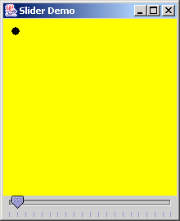
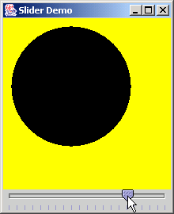
SliderDemo.java
52 public static void main( String args[] )
53 {
54 SliderDemo application = new SliderDemo();
55 application.setDefaultCloseOperation( JFrame.EXIT_ON_CLOSE );
56 }
57
58 } // end class SliderDemo

Slide 27
14.6 Windows: Additional Notes
JFrame
  Windows with title bar and border
  Subclass of java.awt.Frame
    Subclass of java.awt.Window
  Heavyweight component
  Three operations when user closes window
    DISPOSE_ON_CLOSE
    DO_NOTHING_ON_CLOSE
    HIDE_ON_CLOSE

Slide 28
14.7 Using Menus with Frames
Menus
  Allows for performing actions with cluttering GUI
  Contained by menu bar
    JMenuBar
  Comprised of menu items
    JMenuItem

Slide 29
MenuTest.java
Line 22
1 // Fig. 14.9: MenuTest.java
2 // Demonstrating menus
3 import java.awt.*;
4 import java.awt.event.*;
5 import javax.swing.*;
6
7 public class MenuTest extends JFrame {
8 private final Color colorValues[] =
9 { Color.BLACK, Color.BLUE, Color.RED, Color.GREEN };
10 private JRadioButtonMenuItem colorItems[], fonts[];
11 private JCheckBoxMenuItem styleItems[];
12 private JLabel displayLabel;
13 private ButtonGroup fontGroup, colorGroup;
14 private int style;
15
16 // set up GUI
17 public MenuTest()
18 {
19 super( "Using JMenus" );
20
21 // set up File menu and its menu items
22 JMenu fileMenu = new JMenu( "File" );
23 fileMenu.setMnemonic( 'F' );
24
Instantiate File JMenu

Slide 30
MenuTest.java
Line 26
Lines 36-38
Line 46
25 // set up About... menu item
26 JMenuItem aboutItem = new JMenuItem( "About..." );
27 aboutItem.setMnemonic( 'A' );
28 fileMenu.add( aboutItem );
29 aboutItem.addActionListener(
30
31 new ActionListener() { // anonymous inner class
32
33 // display message dialog when user selects About...
34 public void actionPerformed( ActionEvent event )
35 {
36 JOptionPane.showMessageDialog( MenuTest.this,
37 "This is an example\nof using menus",
38 "About", JOptionPane.PLAIN_MESSAGE );
39 }
40
41 } // end anonymous inner class
42
43 ); // end call to addActionListener
44
45 // set up Exit menu item
46 JMenuItem exitItem = new JMenuItem( "Exit" );
47 exitItem.setMnemonic( 'x' );
48 fileMenu.add( exitItem );
49 exitItem.addActionListener(
50
Instantiate About… JMenuItem to be placed in fileMenu
When user selects About… JMenuItem, display message dialog with appropriate text
Instantiate Exit JMenuItem to be placed in fileMenu

Slide 31
MenuTest.java
Line 56
Line 64
Line 69
51 new ActionListener() { // anonymous inner class
52
53 // terminate application when user clicks exitItem
54 public void actionPerformed( ActionEvent event )
55 {
56 System.exit( 0 );
57 }
58
59 } // end anonymous inner class
60
61 ); // end call to addActionListener
62
63 // create menu bar and attach it to MenuTest window
64 JMenuBar bar = new JMenuBar();
65 setJMenuBar( bar );
66 bar.add( fileMenu );
67
68 // create Format menu, its submenus and menu items
69 JMenu formatMenu = new JMenu( "Format" );
70 formatMenu.setMnemonic( 'r' );
71
72 // create Color submenu
73 String colors[] = { "Black", "Blue", "Red", "Green" };
74
When user selects Exit JMenuItem, exit system
Instantiate JMenuBar to contain JMenus
Instantiate Format JMenu

Slide 32
MenuTest.java
Line 75
Lines 78-79
Line 96
Instantiate Color JMenu (submenu of Format JMenu)
75 JMenu colorMenu = new JMenu( "Color" );
76 colorMenu.setMnemonic( 'C' );
77
78 colorItems = new JRadioButtonMenuItem[ colors.length ];
79 colorGroup = new ButtonGroup();
80 ItemHandler itemHandler = new ItemHandler();
81
82 // create color radio button menu items
83 for ( int count = 0; count < colors.length; count++ ) {
84 colorItems[ count ] =
85 new JRadioButtonMenuItem( colors[ count ] );
86 colorMenu.add( colorItems[ count ] );
87 colorGroup.add( colorItems[ count ] );
88 colorItems[ count ].addActionListener( itemHandler );
89 }
90
91 // select first Color menu item
92 colorItems[ 0 ].setSelected( true );
93
94 // add format menu to menu bar
95 formatMenu.add( colorMenu );
96 formatMenu.addSeparator();
97
98 // create Font submenu
99 String fontNames[] = { "Serif", "Monospaced", "SansSerif" };
100
Instantiate JRadioButtonMenuItems for Color JMenu and ensure that only one menu item is selected at a time
Separator places line between JMenuItems

Slide 33
MenuTest.java
Line 101
Lines 104-105
Instantiate Font JMenu (submenu of Format JMenu)
101 JMenu fontMenu = new JMenu( "Font" );
102 fontMenu.setMnemonic( 'n' );
103
104 fonts = new JRadioButtonMenuItem[ fontNames.length ];
105 fontGroup = new ButtonGroup();
106
107 // create Font radio button menu items
108 for ( int count = 0; count < fonts.length; count++ ) {
109 fonts[ count ] = new JRadioButtonMenuItem( fontNames[ count ] );
110 fontMenu.add( fonts[ count ] );
111 fontGroup.add( fonts[ count ] );
112 fonts[ count ].addActionListener( itemHandler );
113 }
114
115 // select first Font menu item
116 fonts[ 0 ].setSelected( true );
117
118 fontMenu.addSeparator();
119
120 // set up style menu items
121 String styleNames[] = { "Bold", "Italic" };
122
123 styleItems = new JCheckBoxMenuItem[ styleNames.length ];
124 StyleHandler styleHandler = new StyleHandler();
125
Instantiate JRadioButtonMenuItems for Font JMenu and ensure that only one menu item is selected at a time

Slide 34
MenuTest.java
126 // create style checkbox menu items
127 for ( int count = 0; count < styleNames.length; count++ ) {
128 styleItems[ count ] =
129 new JCheckBoxMenuItem( styleNames[ count ] );
130 fontMenu.add( styleItems[ count ] );
131 styleItems[ count ].addItemListener( styleHandler );
132 }
133
134 // put Font menu in Format menu
135 formatMenu.add( fontMenu );
136
137 // add Format menu to menu bar
138 bar.add( formatMenu );
139
140 // set up label to display text
141 displayLabel = new JLabel( "Sample Text", SwingConstants.CENTER );
142 displayLabel.setForeground( colorValues[ 0 ] );
143 displayLabel.setFont( new Font( "Serif", Font.PLAIN, 72 ) );
144
145 getContentPane().setBackground( Color.CYAN );
146 getContentPane().add( displayLabel, BorderLayout.CENTER );
147
148 setSize( 500, 200 );
149 setVisible( true );
150
151 } // end constructor
152

Slide 35
MenuTest.java
Line 163
Lines 168 and 176
Lines 169 and 177-178
153 public static void main( String args[] )
154 {
155 MenuTest application = new MenuTest();
156 application.setDefaultCloseOperation( JFrame.EXIT_ON_CLOSE );
157 }
158
159 // inner class to handle action events from menu items
160 private class ItemHandler implements ActionListener {
161
162 // process color and font selections
163 public void actionPerformed( ActionEvent event )
164 {
165 // process color selection
166 for ( int count = 0; count < colorItems.length; count++ )
167
168 if ( colorItems[ count ].isSelected() ) {
169 displayLabel.setForeground( colorValues[ count ] );
170 break;
171 }
172
173 // process font selection
174 for ( int count = 0; count < fonts.length; count++ )
175
176 if ( event.getSource() == fonts[ count ] ) {
177 displayLabel.setFont(
178 new Font( fonts[ count ].getText(), style, 72 ) );
179 break;
180 }
Invoked when user selects JMenuItem
Determine which font or color menu generated event
Set font or color of JLabel, respectively

Slide 36
MenuTest.java
Line 192
Lines 197-202
181
182 repaint();
183
184 } // end method actionPerformed
185
186 } // end class ItemHandler
187
188 // inner class to handle item events from check box menu items
189 private class StyleHandler implements ItemListener {
190
191 // process font style selections
192 public void itemStateChanged( ItemEvent e )
193 {
194 style = 0;
195
196 // check for bold selection
197 if ( styleItems[ 0 ].isSelected() )
198 style += Font.BOLD;
199
200 // check for italic selection
201 if ( styleItems[ 1 ].isSelected() )
202 style += Font.ITALIC;
203
204 displayLabel.setFont(
205 new Font( displayLabel.getFont().getName(), style, 72 ) );
Invoked when user selects JCheckBoxMenuItem
Determine new font style

Slide 37
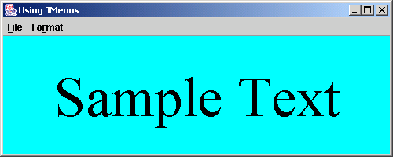
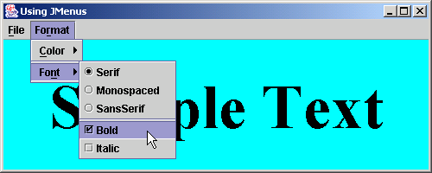
MenuTest.java
206
207 repaint();
208 }
209
210 } // end class StyleHandler
211
212 } // end class MenuTest

Slide 38
14.8 JPopupMenu
Context-sensitive popup menus
  JPopupMenu
  Menu generated depending on which component is accessed

Slide 39
PopupTest.java
Line 23
1 // Fig. 14.10: PopupTest.java
2 // Demonstrating JPopupMenus
3 import java.awt.*;
4 import java.awt.event.*;
5 import javax.swing.*;
6
7 public class PopupTest extends JFrame {
8 private JRadioButtonMenuItem items[];
9 private final Color colorValues[] =
10 { Color.BLUE, Color.YELLOW, Color.RED };
11 private JPopupMenu popupMenu;
12
13 // set up GUI
14 public PopupTest()
15 {
16 super( "Using JPopupMenus" );
17
18 ItemHandler handler = new ItemHandler();
19 String colors[] = { "Blue", "Yellow", "Red" };
20
21 // set up popup menu and its items
22 ButtonGroup colorGroup = new ButtonGroup();
23 popupMenu = new JPopupMenu();
24 items = new JRadioButtonMenuItem[ 3 ];
25
Instantiate JPopupMenu object

Slide 40
PopupTest.java
Lines 29-32
Lines 46 and 52
26 // construct each menu item and add to popup menu; also
27 // enable event handling for each menu item
28 for ( int count = 0; count < items.length; count++ ) {
29 items[ count ] = new JRadioButtonMenuItem( colors[ count ] );
30 popupMenu.add( items[ count ] );
31 colorGroup.add( items[ count ] );
32 items[ count ].addActionListener( handler );
33 }
34
35 getContentPane().setBackground( Color.WHITE );
36
37 // declare a MouseListener for the window that displays
38 // a JPopupMenu when the popup trigger event occurs
39 addMouseListener(
40
41 new MouseAdapter() { // anonymous inner class
42
43 // handle mouse press event
44 public void mousePressed( MouseEvent event )
45 {
46 checkForTriggerEvent( event );
47 }
48
49 // handle mouse release event
50 public void mouseReleased( MouseEvent event )
51 {
52 checkForTriggerEvent( event );
53 }
Create JRadioButtonMenuItem objects to add to JPopupMenu
Determine whether popup-trigger event occurred when user presses or releases mouse button

Slide 41
PopupTest.java
Lines 59-60
54
55 // determine whether event should trigger popup menu
56 private void checkForTriggerEvent( MouseEvent event )
57 {
58 if ( event.isPopupTrigger() )
59 popupMenu.show(
60 event.getComponent(), event.getX(), event.getY() );
61 }
62
63 } // end anonymous inner clas
64
65 ); // end call to addMouseListener
66
67 setSize( 300, 200 );
68 setVisible( true );
69
70 } // end constructor PopupTest
71
72 public static void main( String args[] )
73 {
74 PopupTest application = new PopupTest();
75 application.setDefaultCloseOperation( JFrame.EXIT_ON_CLOSE );
76 }
77
Show JPopupMenu if popup-trigger occurred

Slide 42
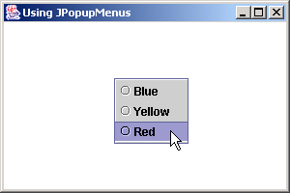
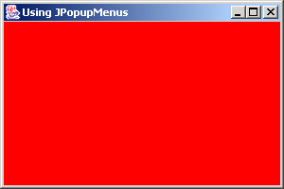
PopupTest.java
Line 82
Line 87
78 // private inner class to handle menu item events
79 private class ItemHandler implements ActionListener {
80
81 // process menu item selections
82 public void actionPerformed( ActionEvent event )
83 {
84 // determine which menu item was selected
85 for ( int i = 0; i < items.length; i++ )
86 if ( event.getSource() == items[ i ] ) {
87 getContentPane().setBackground( colorValues[ i ] );
88 return;
89 }
90 }
91
92 } // end private inner class ItemHandler
93
94 } // end class PopupTest
Invoked when user selects JRadioButtonMenuItem
Determine which JRadioButtonMenuItem was selected, then set window background color

Slide 43
14.9 Pluggable Look-and-Feel
Pluggable look-and-feel
  Change look-and-feel dynamically
    e.g., Microsoft Windows look-and-feel to Motif look-and-feel
  Flexible

Slide 44
LookAndFeelDemo.java
Line 9
1 // Fig. 14.11: LookAndFeelDemo.java
2 // Changing the look and feel.
3 import java.awt.*;
4 import java.awt.event.*;
5 import javax.swing.*;
6
7 public class LookAndFeelDemo extends JFrame {
8 private final String strings[] = { "Metal", "Motif", "Windows" };
9 private UIManager.LookAndFeelInfo looks[];
10 private JRadioButton radio[];
11 private ButtonGroup group;
12 private JButton button;
13 private JLabel label;
14 private JComboBox comboBox;
15
16 // set up GUI
17 public LookAndFeelDemo()
18 {
19 super( "Look and Feel Demo" );
20
21 Container container = getContentPane();
22
23 // set up panel for NORTH of BorderLayout
24 JPanel northPanel = new JPanel();
25 northPanel.setLayout( new GridLayout( 3, 1, 0, 5 ) );
26
Hold installed look-and-feel information

Slide 45
LookAndFeelDemo.java
27 // set up label for NORTH panel
28 label = new JLabel( "This is a Metal look-and-feel",
29 SwingConstants.CENTER );
30 northPanel.add( label );
31
32 // set up button for NORTH panel
33 button = new JButton( "JButton" );
34 northPanel.add( button );
35
36 // set up combo box for NORTH panel
37 comboBox = new JComboBox( strings );
38 northPanel.add( comboBox );
39
40 // create array for radio buttons
41 radio = new JRadioButton[ strings.length ];
42
43 // set up panel for SOUTH of BorderLayout
44 JPanel southPanel = new JPanel();
45 southPanel.setLayout( new GridLayout( 1, radio.length ) );
46
47 // set up radio buttons for SOUTH panel
48 group = new ButtonGroup();
49 ItemHandler handler = new ItemHandler();
50

Slide 46
LookAndFeelDemo.java
51 for ( int count = 0; count < radio.length; count++ ) {
52 radio[ count ] = new JRadioButton( strings[ count ] );
53 radio[ count ].addItemListener( handler );
54 group.add( radio[ count ] );
55 southPanel.add( radio[ count ] );
56 }
57
58 // attach NORTH and SOUTH panels to content pane
59 container.add( northPanel, BorderLayout.NORTH );
60 container.add( southPanel, BorderLayout.SOUTH );
61
62 // get installed look-and-feel information
63 looks = UIManager.getInstalledLookAndFeels();
64
65 setSize( 300, 200 );
66 setVisible( true );
67
68 radio[ 0 ].setSelected( true );
69
70 } // end constructor LookAndFeelDemo
71
72 // use UIManager to change look-and-feel of GUI
73 private void changeTheLookAndFeel( int value )
74 {

Slide 47
LookAndFeelDemo.java
Lines 77-78
75 // change look and feel
76 try {
77 UIManager.setLookAndFeel( looks[ value ].getClassName() );
78 SwingUtilities.updateComponentTreeUI( this );
79 }
80
81 // process problems changing look and feel
82 catch ( Exception exception ) {
83 exception.printStackTrace();
84 }
85 }
86
87 public static void main( String args[] )
88 {
89 LookAndFeelDemo application = new LookAndFeelDemo();
90 application.setDefaultCloseOperation( JFrame.EXIT_ON_CLOSE );
91 }
92
93 // private inner class to handle radio button events
94 private class ItemHandler implements ItemListener {
95
96 // process user's look-and-feel selection
97 public void itemStateChanged( ItemEvent event )
98 {
99 for ( int count = 0; count < radio.length; count++ )
100
Change look-and-feel

Slide 48
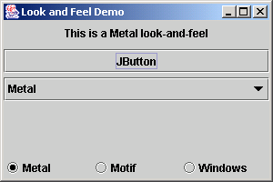
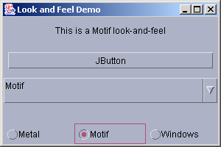
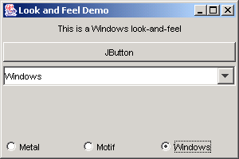
LookAndFeelDemo.java
101 if ( radio[ count ].isSelected() ) {
102 label.setText( "This is a " +
103 strings[ count ] + " look-and-feel" );
104 comboBox.setSelectedIndex( count );
105 changeTheLookAndFeel( count );
106 }
107 }
108
109 } // end private inner class ItemHandler
110
111 } // end class LookAndFeelDemo

Slide 49
14.10 JDesktopPane and JInternalFrame
Multiple document interface
  Main (parent) window
  Child windows
  Switch freely among documents

Slide 50
DesktopTest.java
Line 8
1 // Fig. 14.12: DesktopTest.java
2 // Demonstrating JDesktopPane.
3 import java.awt.*;
4 import java.awt.event.*;
5 import javax.swing.*;
6
7 public class DesktopTest extends JFrame {
8 private JDesktopPane theDesktop;
9
10 // set up GUI
11 public DesktopTest()
12 {
13 super( "Using a JDesktopPane" );
14
15 // create menu bar, menu and menu item
16 JMenuBar bar = new JMenuBar();
17 JMenu addMenu = new JMenu( "Add" );
18 JMenuItem newFrame = new JMenuItem( "Internal Frame" );
19
20 addMenu.add( newFrame );
21 bar.add( addMenu );
22
23 setJMenuBar( bar );
24
25 // set up desktop
26 theDesktop = new JDesktopPane();
27 getContentPane().add( theDesktop );
Manages JInternalFrame child windows displayed in JDesktopPane

Slide 51
DesktopTest.java
Line 30
Line 35
Lines 38-39
Lines 43-44
Line 47
28
29 // set up listener for newFrame menu item
30 newFrame.addActionListener(
31
32 new ActionListener() { // anonymous inner class
33
34 // display new internal window
35 public void actionPerformed( ActionEvent event ) {
36
37 // create internal frame
38 JInternalFrame frame = new JInternalFrame(
39 "Internal Frame", true, true, true, true );
40
41 // attach panel to internal frame content pane
42 Container container = frame.getContentPane();
43 MyJPanel panel = new MyJPanel();
44 container.add( panel, BorderLayout.CENTER );
45
46 // set size internal frame to size of its contents
47 frame.pack();
48
49 // attach internal frame to desktop and show it
50 theDesktop.add( frame );
51 frame.setVisible( true );
52 }
53
54 } // end anonymous inner class
Handle event when user selects JMenuItem
Invoked when user selects JMenuItem
Create JInternalFrame
JPanels can be added to JInternalFrames
Use preferred size for window

Slide 52
DesktopTest.java
55
56 ); // end call to addActionListener
57
58 setSize( 600, 460 );
59 setVisible( true );
60
61 } // end constructor
62
63 public static void main( String args[] )
64 {
65 DesktopTest application = new DesktopTest();
66 application.setDefaultCloseOperation( JFrame.EXIT_ON_CLOSE );
67 }
68
69 } // end class DesktopTest
70
71 // class to display an ImageIcon on a panel
72 class MyJPanel extends JPanel {
73 private ImageIcon imageIcon;
74 private String[] images = { "yellowflowers.png", "purpleflowers.png",
75 "redflowers.png", "redflowers2.png", "lavenderflowers.png" };
76
77 // load image
78 public MyJPanel()
79 {

Slide 53
DesktopTest.java
80 int randomNumber = ( int ) ( Math.random() * 5 );
81 imageIcon = new ImageIcon( images[ randomNumber ] );
82 }
83
84 // display imageIcon on panel
85 public void paintComponent( Graphics g )
86 {
87 // call superclass paintComponent method
88 super.paintComponent( g );
89
90 // display icon
91 imageIcon.paintIcon( this, g, 0, 0 );
92 }
93
94 // return image dimensions
95 public Dimension getPreferredSize()
96 {
97 return new Dimension( imageIcon.getIconWidth(),
98 imageIcon.getIconHeight() );
99 }
100
101 } // end class MyJPanel

Slide 54
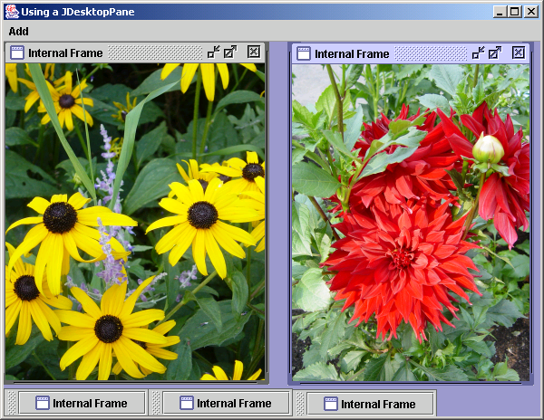
DesktopTest.java
Internal Frames
Minimize
Maximize
Close
Position the mouse over any corner of a child window to resize the window (if resizing is allowed).
Minimized internal frames

Slide 55
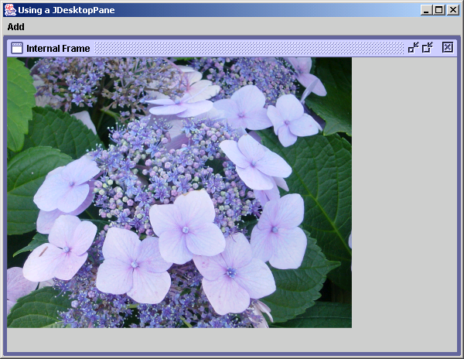
DesktopTest.java

Slide 56
14.11 JTabbedPane
Arranges GUI components into layers
  One layer visible at a time
  Access each layer via a tab
  JTabbedPane

Slide 57
JTabbedPaneDemo.java
Line 14
Line20
Line 27
1 // Fig. 14.13: JTabbedPaneDemo.java
2 // Demonstrating JTabbedPane.
3 import java.awt.*;
4 import javax.swing.*;
5
6 public class JTabbedPaneDemo extends JFrame {
7
8 // set up GUI
9 public JTabbedPaneDemo()
10 {
11 super( "JTabbedPane Demo " );
12
13 // create JTabbedPane
14 JTabbedPane tabbedPane = new JTabbedPane();
15
16 // set up pane11 and add it to JTabbedPane
17 JLabel label1 = new JLabel( "panel one", SwingConstants.CENTER );
18 JPanel panel1 = new JPanel();
19 panel1.add( label1 );
20 tabbedPane.addTab( "Tab One", null, panel1, "First Panel" );
21
22 // set up panel2 and add it to JTabbedPane
23 JLabel label2 = new JLabel( "panel two", SwingConstants.CENTER );
24 JPanel panel2 = new JPanel();
25 panel2.setBackground( Color.YELLOW );
26 panel2.add( label2 );
27 tabbedPane.addTab( "Tab Two", null, panel2, "Second Panel" );
Create a JTabbedPane
Add the first panel
Add the second panel

Slide 58
JTabbedPaneDemo.java
Line 38
28
29 // set up panel3 and add it to JTabbedPane
30 JLabel label3 = new JLabel( "panel three" );
31 JPanel panel3 = new JPanel();
32 panel3.setLayout( new BorderLayout() );
33 panel3.add( new JButton( "North" ), BorderLayout.NORTH );
34 panel3.add( new JButton( "West" ), BorderLayout.WEST );
35 panel3.add( new JButton( "East" ), BorderLayout.EAST );
36 panel3.add( new JButton( "South" ), BorderLayout.SOUTH );
37 panel3.add( label3, BorderLayout.CENTER );
38 tabbedPane.addTab( "Tab Three", null, panel3, "Third Panel" );
39
40 // add JTabbedPane to container
41 getContentPane().add( tabbedPane );
42
43 setSize( 250, 200 );
44 setVisible( true );
45
46 } // end constructor
47
48 public static void main( String args[] )
49 {
50 JTabbedPaneDemo tabbedPaneDemo = new JTabbedPaneDemo();
51 tabbedPaneDemo.setDefaultCloseOperation( JFrame.EXIT_ON_CLOSE );
52 }
53
54 } // end class CardDeck
Add the third panel

Slide 59
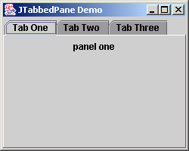
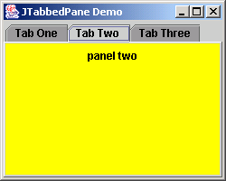
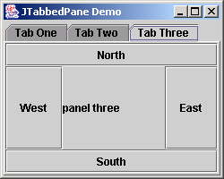
JTabbedPaneDemo.java

Slide 60
14.12 Layout Managers: BoxLayout and GridBagLayout
Layout Managers
  BoxLayout
  GridBagLayout

Slide 61
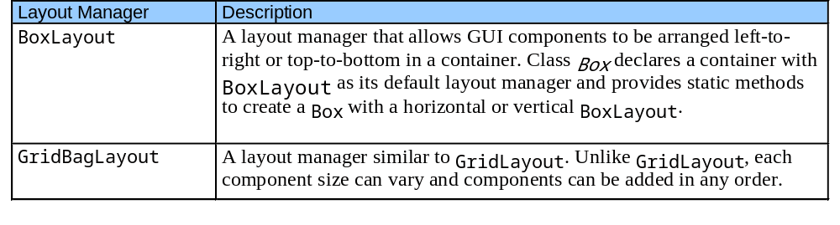
Fig. 14.14 Additional layout managers

Slide 62
BoxLayout Layout Manager
BoxLayout
  Arranges GUI components
    Horizontally along x-axis
    Vertically along y-axis

Slide 63
BoxLayoutDemo.java
Lines 15-18
Line 24
1 // Fig. 14.15: BoxLayoutDemo.java
2 // Demonstrating BoxLayout.
3 import java.awt.*;
4 import java.awt.event.*;
5 import javax.swing.*;
6
7 public class BoxLayoutDemo extends JFrame {
8
9 // set up GUI
10 public BoxLayoutDemo()
11 {
12 super( "Demostrating BoxLayout" );
13
14 // create Box containers with BoxLayout
15 Box horizontal1 = Box.createHorizontalBox();
16 Box vertical1 = Box.createVerticalBox();
17 Box horizontal2 = Box.createHorizontalBox();
18 Box vertical2 = Box.createVerticalBox();
19
20 final int SIZE = 3; // number of buttons on each Box
21
22 // add buttons to Box horizontal1
23 for ( int count = 0; count < SIZE; count++ )
24 horizontal1.add( new JButton( "Button " + count ) );
25
Create Boxes
Add three JButtons to horizontal Box

Slide 64
BoxLayoutDemo.java
Lines 27-30
Line 28
Lines 33-36
Line 34
Lines 39-42
Line 40
26 // create strut and add buttons to Box vertical1
27 for ( int count = 0; count < SIZE; count++ ) {
28 vertical1.add( Box.createVerticalStrut( 25 ) );
29 vertical1.add( new JButton( "Button " + count ) );
30 }
31
32 // create horizontal glue and add buttons to Box horizontal2
33 for ( int count = 0; count < SIZE; count++ ) {
34 horizontal2.add( Box.createHorizontalGlue() );
35 horizontal2.add( new JButton( "Button " + count ) );
36 }
37
38 // create rigid area and add buttons to Box vertical2
39 for ( int count = 0; count < SIZE; count++ ) {
40 vertical2.add( Box.createRigidArea( new Dimension( 12, 8 ) ) );
41 vertical2.add( new JButton( "Button " + count ) );
42 }
43
44 // create vertical glue and add buttons to panel
45 JPanel panel = new JPanel();
46 panel.setLayout( new BoxLayout( panel, BoxLayout.Y_AXIS ) );
47
48 for ( int count = 0; count < SIZE; count++ ) {
49 panel.add( Box.createGlue() );
50 panel.add( new JButton( "Button " + count ) );
51 }
52
Add three JButtons to vertical Box
Strut guarantees space between components
Add three JButtons to horizontal Box
Glue guarantees expandable space between components
Add three JButtons to vertical Box
Rigid area guarantees fixed component size

Slide 65
BoxLayoutDemo.java
Lines 54-55
53 // create a JTabbedPane
54 JTabbedPane tabs = new JTabbedPane(
55 JTabbedPane.TOP, JTabbedPane.SCROLL_TAB_LAYOUT );
56
57 // place each container on tabbed pane
58 tabs.addTab( "Horizontal Box", horizontal1 );
59 tabs.addTab( "Vertical Box with Struts", vertical1 );
60 tabs.addTab( "Horizontal Box with Glue", horizontal2 );
61 tabs.addTab( "Vertical Box with Rigid Areas", vertical2 );
62 tabs.addTab( "Vertical Box with Glue", panel );
63
64 getContentPane().add( tabs ); // place tabbed pane on content pane
65
66 setSize( 400, 220 );
67 setVisible( true );
68
69 } // end constructor
70
71 public static void main( String args[] )
72 {
73 BoxLayoutDemo application = new BoxLayoutDemo();
74 application.setDefaultCloseOperation( JFrame.EXIT_ON_CLOSE );
75 }
76
77 } // end class BoxLayoutDemo
Create a JTabbedPane to hold the Boxes

Slide 66
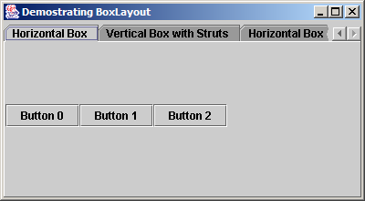
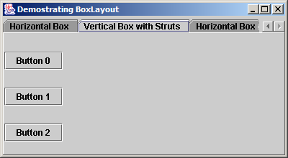
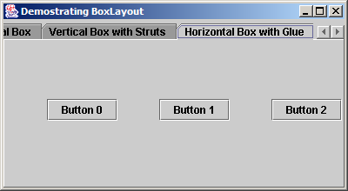
BoxLayoutDemo.java

Slide 67
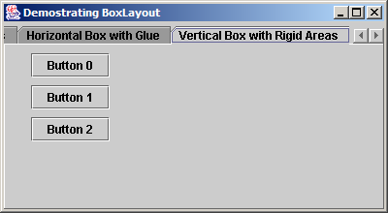
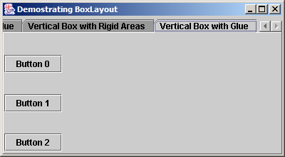
BoxLayoutDemo.java

Slide 68
GridBagLayout Layout Manager
GridBagLayout
  Flexible GridBagLayout
    Components can vary in size
    Components can occupy multiple rows and columns
    Components can be added in any order
  Uses GridBagConstraints
    Specifies how component is placed in GridBagLayout

Slide 69
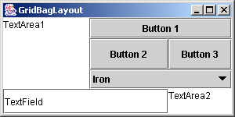
Fig. 14.16 Designing a GUI that will use GridBagLayout
Column
0
1
2
0
1
Row
2
3

Slide 70
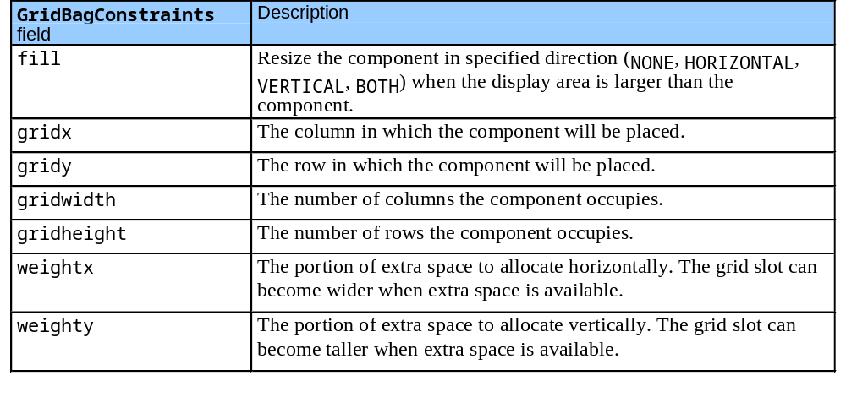
Fig. 14.17 GridBagConstraints fields

Slide 71
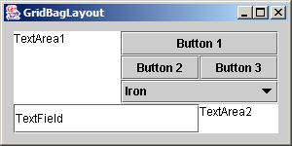
Fig. 14.18 GridBagLayout with the weights set to zero

Slide 72
GridBagDemo.java
Line 19
Line 22
1 // Fig. 14.19: GridBagDemo.java
2 // Demonstrating GridBagLayout.
3 import java.awt.*;
4 import java.awt.event.*;
5 import javax.swing.*;
6
7 public class GridBagDemo extends JFrame {
8 private Container container;
9 private GridBagLayout layout;
10 private GridBagConstraints constraints;
11
12 // set up GUI
13 public GridBagDemo()
14 {
15 super( "GridBagLayout" );
16
17 container = getContentPane();
18 layout = new GridBagLayout();
19 container.setLayout( layout );
20
21 // instantiate gridbag constraints
22 constraints = new GridBagConstraints();
23
24 // create GUI components
25 JTextArea textArea1 = new JTextArea( "TextArea1", 5, 10 );
26 JTextArea textArea2 = new JTextArea( "TextArea2", 2, 2 );
27
Set GridBagLayout as layout manager
Used to determine component location and size in grid

Slide 73
GridBagDemo.java
Line 38
Line 39
Line 42
Line 43
Line 51
28 String names[] = { "Iron", "Steel", "Brass" };
29 JComboBox comboBox = new JComboBox( names );
30
31 JTextField textField = new JTextField( "TextField" );
32 JButton button1 = new JButton( "Button 1" );
33 JButton button2 = new JButton( "Button 2" );
34 JButton button3 = new JButton( "Button 3" );
35
36 // weightx and weighty for textArea1 are both 0: the default
37 // anchor for all components is CENTER: the default
38 constraints.fill = GridBagConstraints.BOTH;
39 addComponent( textArea1, 0, 0, 1, 3 );
40
41 // weightx and weighty for button1 are both 0: the default
42 constraints.fill = GridBagConstraints.HORIZONTAL;
43 addComponent( button1, 0, 1, 2, 1 );
44
45 // weightx and weighty for comboBox are both 0: the default
46 // fill is HORIZONTAL
47 addComponent( comboBox, 2, 1, 2, 1 );
48
49 // button2
50 constraints.weightx = 1000; // can grow wider
51 constraints.weighty = 1; // can grow taller
52 constraints.fill = GridBagConstraints.BOTH;
53 addComponent( button2, 1, 1, 1, 1 );
54
If user resizes Container, first JTextArea is filled entire allocated area in grid
First JTextArea spans one row and three columns
If user resizes Container, first JButton fills horizontally in grid
First JButton spans two rows and one column
If user resizes Container, second JButton fills extra space

Slide 74
GridBagDemo.java
55 // fill is BOTH for button3
56 constraints.weightx = 0;
57 constraints.weighty = 0;
58 addComponent( button3, 1, 2, 1, 1 );
59
60 // weightx and weighty for textField are both 0, fill is BOTH
61 addComponent( textField, 3, 0, 2, 1 );
62
63 // weightx and weighty for textArea2 are both 0, fill is BOTH
64 addComponent( textArea2, 3, 2, 1, 1 );
65
66 setSize( 300, 150 );
67 setVisible( true );
68
69 } // end constructor GridBagDemo
70
71 // method to set constraints on
72 private void addComponent( Component component,
73 int row, int column, int width, int height )
74 {
75 // set gridx and gridy
76 constraints.gridx = column;
77 constraints.gridy = row;
78

Slide 75
GridBagDemo.java
79 // set gridwidth and gridheight
80 constraints.gridwidth = width;
81 constraints.gridheight = height;
82
83 // set constraints and add component
84 layout.setConstraints( component, constraints );
85 container.add( component );
86 }
87
88 public static void main( String args[] )
89 {
90 GridBagDemo application = new GridBagDemo();
91 application.setDefaultCloseOperation( JFrame.EXIT_ON_CLOSE );
92 }
93
94 } // end class GridBagDemo

Slide 76
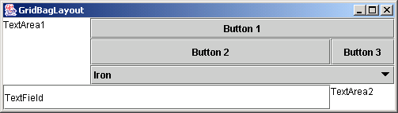
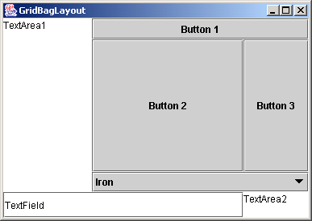
GridBagDemo.java

Slide 77
GridBagConstraints Constants RELATIVE and REMAINDER
Constants RELATIVE and REMAINDER
  Used in place of variables gridx and gridy
  RELATIVE
    Specifies next-to-last component placement in row or column
      Component should be placed next to one previously added
  REMAINDER
    Specifies component as last component in row or column

Slide 78
GridBagDemo2.java
Lines 18-19
Line 22
1 // Fig. 14.20: GridBagDemo2.java
2 // Demonstrating GridBagLayout constants.
3 import java.awt.*;
4 import java.awt.event.*;
5 import javax.swing.*;
6
7 public class GridBagDemo2 extends JFrame {
8 private GridBagLayout layout;
9 private GridBagConstraints constraints;
10 private Container container;
11
12 // set up GUI
13 public GridBagDemo2()
14 {
15 super( "GridBagLayout" );
16
17 container = getContentPane();
18 layout = new GridBagLayout();
19 container.setLayout( layout );
20
21 // instantiate gridbag constraints
22 constraints = new GridBagConstraints();
23
24 // create GUI components
25 String metals[] = { "Copper", "Aluminum", "Silver" };
26 JComboBox comboBox = new JComboBox( metals );
27
Set GridBagLayout as layout manager
Used to determine component location and size in grid

Slide 79
GridBagDemo2.java
Line 43
Line 48
Line 52
28 JTextField textField = new JTextField( "TextField" );
29
30 String fonts[] = { "Serif", "Monospaced" };
31 JList list = new JList( fonts );
32
33 String names[] = { "zero", "one", "two", "three", "four" };
34 JButton buttons[] = new JButton[ names.length ];
35
36 for ( int count = 0; count < buttons.length; count++ )
37 buttons[ count ] = new JButton( names[ count ] );
38
39 // define GUI component constraints for textField
40 constraints.weightx = 1;
41 constraints.weighty = 1;
42 constraints.fill = GridBagConstraints.BOTH;
43 constraints.gridwidth = GridBagConstraints.REMAINDER;
44 addComponent( textField );
45
46 // buttons[0] -- weightx and weighty are 1: fill is BOTH
47 constraints.gridwidth = 1;
48 addComponent( buttons[ 0 ] );
49
50 // buttons[1] -- weightx and weighty are 1: fill is BOTH
51 constraints.gridwidth = GridBagConstraints.RELATIVE;
52 addComponent( buttons[ 1 ] );
53
Specify textField as last (only) component in first row
Place button[0] as first component in second row
Place button[1] right next to button[0]

Slide 80
GridBagDemo2.java
Line 56
Line 61
Line 66
Line 70
Line 74
54 // buttons[2] -- weightx and weighty are 1: fill is BOTH
55 constraints.gridwidth = GridBagConstraints.REMAINDER;
56 addComponent( buttons[ 2 ] );
57
58 // comboBox -- weightx is 1: fill is BOTH
59 constraints.weighty = 0;
60 constraints.gridwidth = GridBagConstraints.REMAINDER;
61 addComponent( comboBox );
62
63 // buttons[3] -- weightx is 1: fill is BOTH
64 constraints.weighty = 1;
65 constraints.gridwidth = GridBagConstraints.REMAINDER;
66 addComponent( buttons[ 3 ] );
67
68 // buttons[4] -- weightx and weighty are 1: fill is BOTH
69 constraints.gridwidth = GridBagConstraints.RELATIVE;
70 addComponent( buttons[ 4 ] );
71
72 // list -- weightx and weighty are 1: fill is BOTH
73 constraints.gridwidth = GridBagConstraints.REMAINDER;
74 addComponent( list );
75
76 setSize( 300, 200 );
77 setVisible( true );
78
79 } // end constructor
80
Place button[2] right next to button[1]
Specify comboBox as last (only) component in third row
Specify buttons[3] as last (only) component in fourth row
Place button[4] as first component in fifth row
Specify list as last component in fifth row

Slide 81
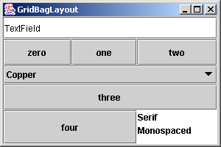
GridBagDemo2.java
81 // add a Component to the container
82 private void addComponent( Component component )
83 {
84 layout.setConstraints( component, constraints );
85 container.add( component ); // add component
86 }
87
88 public static void main( String args[] )
89 {
90 GridBagDemo2 application = new GridBagDemo2();
91 application.setDefaultCloseOperation( JFrame.EXIT_ON_CLOSE );
92 }
93
94 } // end class GridBagDemo2

Slide 82
14.13 (Optional Case Study) Thinking About Objects: Model-View-Controller
Model-View-Controller
  Architectural pattern for building systems
  Divide system responsibilities into three parts
    Model
      Maintains program data and logic
    View
      Visual representation of model
    Controller
      Processes user input and modifies model
  Step by step
    User uses controller to change data in model
    Model then informs view of change
    View changes visual presentation to reflect change

Slide 83
Model-View-Controller Elevator Simulation
Model-View-Controller in elevator simulation
  Example
    User presses First Floor of Second Floor Jbutton
      Controller adds Person to model
    Model notifies view of Person’s creation
    View displays Person on Floor in response to notification

Slide 84
Fig. 14.21 Class diagram of the elevator simulation
javax.swing.JFrame
application
1
ElevatorCaseStudy
1
1
ElevatorSimulationListener
1
1
1
ElevatorSimulation
ElevatorView
ElevatorController
MVC model
view
controller

Slide 85
14.13 (Optional Case Study) Thinking About Objects: Model-View-Controller
Component diagram (UML)
  Models “pieces” (components) used by system
    e.g., .class file, .java files, images, packages, etc.
  Notation
    Components are represented as “plugs”
    Packages are represented as “folders”
    Dotted arrows indicate dependencies among components
      Changing one component requires changing another

Slide 86
Fig. 14.22 Artifacts of the elevator simulation
model
executable
ElevatorCaseStudy.class
<<file>>
ElevatorSimulation.java
compilation
imports
ElevatorSimulation-
Listener
view
<file>>
<<file>>
imports
ElevatorView.java
ElevatorCaseStudy.java
controller
imports
<file>>
ElevatorController.java

Slide 87
ElevatorController.java
Line 15
Lines 19-20
1 // ElevatorController.java
2 // Controller for Elevator Simulation
3 package com.deitel.jhtp5.elevator.controller;
4
5 import java.awt.*;
6 import java.awt.event.*;
7
8 import javax.swing.*;
9
10 // Deitel packages
11 import com.deitel.jhtp5.elevator.model.*;
12 import com.deitel.jhtp5.elevator.event.*;
13 import com.deitel.jhtp5.elevator.ElevatorConstants;
14
15 public class ElevatorController extends JPanel
16 implements ElevatorConstants {
17
18 // controller contains two JButtons
19 private JButton firstControllerButton;
20 private JButton secondControllerButton;
21
22 // reference to ElevatorSimulation
23 private ElevatorSimulation elevatorSimulation;
24
ElevatorController GUI for elevator simulation
JButtons for creating Persons on Floor

Slide 88
ElevatorController.java
Line 40
Lines 47-48
25 public ElevatorController( ElevatorSimulation simulation )
26 {
27 elevatorSimulation = simulation;
28 setBackground( Color.WHITE );
29
30 // add first button to controller
31 firstControllerButton = new JButton( "First Floor" );
32 add( firstControllerButton );
33
34 // add second button to controller
35 secondControllerButton = new JButton( "Second Floor" );
36 add( secondControllerButton );
37
38 // anonymous inner class registers to receive ActionEvents
39 // from first Controller JButton
40 firstControllerButton.addActionListener(
41 new ActionListener() {
42
43 // invoked when a JButton has been pressed
44 public void actionPerformed( ActionEvent event )
45 {
46 // place Person on first Floor
47 elevatorSimulation.addPerson(
48 FIRST_FLOOR_NAME );
49
Register JButtons with separate anonymous ActionListeners
Add Person to respective Floor, depending on JButton that user pressed

Slide 89
ElevatorController.java
Line 58
Lines 65-66
Lines 51 and 69
50 // disable user input
51 firstControllerButton.setEnabled( false );
52 }
53 } // end anonymous inner class
54 );
55
56 // anonymous inner class registers to receive ActionEvents
57 // from second Controller JButton
58 secondControllerButton.addActionListener(
59 new ActionListener() {
60
61 // invoked when a JButton has been pressed
62 public void actionPerformed( ActionEvent event )
63 {
64 // place Person on second Floor
65 elevatorSimulation.addPerson(
66 SECOND_FLOOR_NAME );
67
68 // disable user input
69 secondControllerButton.setEnabled( false );
70 }
71 } // end anonymous inner class
72 );
73
Register JButtons with separate anonymous ActionListeners
Add Person to respective Floor, depending on JButton that user pressed
Disable JButton after Person is created (so user cannot create more than one Person on Floor)

Slide 90
ElevatorController.java
Line 76
Lines 89 and 93
74 // anonymous inner class enables user input on Floor if
75 // Person enters Elevator on that Floor
76 elevatorSimulation.addPersonMoveListener(
77 new PersonMoveListener() {
78
79 // invoked when Person has entered Elevator
80 public void personEntered(
81 PersonMoveEvent event )
82 {
83 // get Floor of departure
84 String location =
85 event.getLocation().getLocationName();
86
87 // enable first JButton if first Floor departure
88 if ( location.equals( FIRST_FLOOR_NAME ) )
89 firstControllerButton.setEnabled( true );
90
91 // enable second JButton if second Floor
92 else
93 secondControllerButton.setEnabled( true );
94
95 } // end method personEntered
96
97 // other methods implementing PersonMoveListener
98 public void personCreated(
99 PersonMoveEvent event ) {}
100
Enable ElevatorModel to listener for PersonMoveEvents
Enable JButton after Person enters Elevator (so user can create another Person)

Slide 91
ElevatorController.java
101 public void personArrived(
102 PersonMoveEvent event ) {}
103
104 public void personExited(
105 PersonMoveEvent event ) {}
106
107 public void personDeparted(
108 PersonMoveEvent event ) {}
109
110 public void personPressedButton(
111 PersonMoveEvent event ) {}
112
113 } // end anonymous inner class
114 );
115 } // end ElevatorController constructor
116 }

Slide 92
ElevatorConstants.java
1 // ElevatorConstants.java
2 // Constants used between ElevatorModel and ElevatorView
3 package com.deitel.jhtp5.elevator;
4
5 public interface ElevatorConstants {
6
7 public static final String FIRST_FLOOR_NAME = "firstFloor";
8 public static final String SECOND_FLOOR_NAME = "secondFloor";
9 public static final String ELEVATOR_NAME = "elevator";
10 }

Slide 93
14.13 (Optional Case Study) Thinking About Objects: Model-View-Controller
Classes Location
  Subclasses Elevator and Floor
    Attribute capacity no longer needed

Slide 94
Fig. 14.25 Modified class diagram showing generalization of superclass Location and subclasses Elevator and Floor
Location
- locationName : String
# setLocationName( String ) : void
+ getLocationName( ) : String
+ getButton( ) : Button
+ getDoor( ) : Door
Elevator
Floor
- moving : Boolean = false
- summoned : Boolean = false
- currentFloor : Location
- destinationFloor : Location
- travelTime : Integer = 5
+ getButton( ) : Button
+ getDoor( ) : Door
+ ride( ) : void
+ requestElevator( ) : void
+ enterElevator( ) : void
+ exitElevator( ) : void
+ departElevator( ) : void
+ getButton( ) : Button
+ getDoor( ) : Door

Slide 95
ElevatorCaseStudy.java
Lines 12-14
Lines 19-21
1 // ElevatorCaseStudy.java
2 // Application with Elevator Model, View, and Controller (MVC)
3 package com.deitel.jhtp5.elevator;
4
5 // Java core packages
6 import java.awt.*;
7
8 // Java extension packages
9 import javax.swing.*;
10
11 // Deitel packages
12 import com.deitel.jhtp5.elevator.model.*;
13 import com.deitel.jhtp5.elevator.view.*;
14 import com.deitel.jhtp5.elevator.controller.*;
15
16 public class ElevatorCaseStudy extends JFrame {
17
18 // model, view and controller
19 private ElevatorSimulation model;
20 private ElevatorView view;
21 private ElevatorController controller;
22
23 // constructor instantiates model, view, and controller
24 public ElevatorCaseStudy()
25 {
Import packages model, view and controller
ElevatorCaseStudy aggregates one instance each of classes ElevatorSimulation, ElevatorView and ElevatorController

Slide 96
ElevatorCaseStudy.java
Line 34
Lines 37-38
26 super( "Deitel Elevator Simulation" );
27
28 // instantiate model, view and controller
29 model = new ElevatorSimulation();
30 view = new ElevatorView();
31 controller = new ElevatorController( model );
32
33 // register View for Model events
34 model.setElevatorSimulationListener( view );
35
36 // add view and controller to ElevatorCaseStudy
37 getContentPane().add( view, BorderLayout.CENTER );
38 getContentPane().add( controller, BorderLayout.SOUTH );
39
40 } // end ElevatorCaseStudy constructor
41
42 // main method starts program
43 public static void main( String args[] )
44 {
45 // instantiate ElevatorCaseStudy
46 ElevatorCaseStudy simulation = new ElevatorCaseStudy();
47 simulation.setDefaultCloseOperation( EXIT_ON_CLOSE );
48 simulation.pack();
49 simulation.setVisible( true );
50 }
51 }
Register ElevatorSimulation as listener for ElevatorView
Add ElevatorView and ElevatorController to ElevatorCaseStudy

Slide 97
14.14 (Optional) Discovering Design Patterns: Design Patterns Used in Packages java.awt and javax.swing
Continue design-patterns discussion
  Design patterns associated with Java GUI components
    GUI components take advantage of design patterns

Slide 98
14.14.1 Creational Design Patterns
Factory Method design pattern
  Suppose we design system that opens image from file
    Several image formats exist (e.g., GIF, JPEG, etc.)
      Each image format has different structure
    Method createImage of class Component creates Image
    Two Image objects (one for GIF image, one for JPEG image)
    Method createImage uses parameter to determine proper Image subclass from which to instantiate Image object
      createImage( "image.gif" );
      Returns Image object with GIF data
      createImage( "image.jpg" );
      Returns Image object with JPEG data
    Method createImage is called a factory method
      Determines subclass to instantiate object at run time

Slide 99
14.14.2 Structural Design Patterns
Adapter design pattern
  Used with objects with incompatible interfaces
    Allows these objects to collaborate with each other
    Object’s interface adapts to another object’s interface
  Similar to adapter for plug on electrical device
    European electrical sockets differ from those in United States
    American plug will not work with European socket
    Use adapter for plug
  Class MouseAdapter
    Objects that generate MouseEvents adapts to objects that handle MouseEvents

Slide 100
14.14.2 Structural Design Patterns
Bridge design pattern
  Design class Button for Windows and Macintosh systems
    Class contains button information (e.g., String label)
    Subclasses Win32Button and MacButton
      Contain look-and-feel information
    Problem with this approach
      Creating class ImageButton (subclass of Button)
        Requires creating Win32ImageButton and MacImageButton
    Solution:
      Separate abstraction (i.e., Button) from implementation (i.e., Win32Button and MacButton)
      Button contains reference (bridge) to ButtonPeer
        Handles platform-specific implementations

Slide 101
14.14.2 Structural Design Patterns
Composite design pattern
  Organize components into hierarchical structures
    Each node represents component
    All nodes implement same interface
      Polymorphism ensures clients traverse all nodes uniformly
  Used by Swing components
    JPanel is JContainer subclass
    JPanel object can contain GUI component
      JPanel remains unaware of component’s specific type

Slide 102
Fig. 14.27 Inheritance hierarchy for class JPanel
java.awt.Component
java.awt.Container
javax.swing.JComponent
javax.swing.JPanel

Slide 103
14.14.3 Behavioral Design Patterns
Chain-of-Responsibility design pattern
  Determine object that handles message at run time
  Three-line office-phone system
    First line handles call
    If first line is busy, second line handles call
    If second line is busy, third line handles call
  Message sent through “chain”
    Each object in chain decides whether to handle message
      If unable to handle message, that object sends message to next object in chain
  Method processEvent of class Button
    Handles AWTEvent or sends to next object

Slide 104
14.14.3 Behavioral Design Patterns
Command design pattern
  Applications provide several ways to perform same task
    Edit menu with menu items for cutting and copying text
    Toolbar and popup menus may offer same feature
  Encapsulate functionality (command) in reusable object
    e.g., “cut text” functionality
    Functionality can then be added to menus, toolbars, etc.
    Developers code functionality only once

Slide 105
14.14.3 Behavioral Design Patterns
Observer design pattern
  Design program for viewing bank-account information
    Class BankStatementData store bank-statement data
    Class TextDisplay displays data in text format
    Class BarGraphDisplay displays data in bar-graph format
    Class PieChartDisplay displays data in pie-chart format
    BankStatementData (subject) notifies Display classes (observers) to display data when it changes
  Subject notifies observers when subject changes state
    Observers act in response to notification
    Promotes loose coupling
  Used by
    class java.util.Observable
    class java.util.Observer

Slide 106
Fig. 14.28 Basis for the Observer design pattern
Observers
TextDisplay
Subject
notifies
BankStatementData
notifies
BarGraphDisplay
notifies
PieChartDisplay

Slide 107
14.14.3 Behavioral Design Patterns
Strategy design pattern
  Encapsulates algorithm
  LayoutManagers are strategy objects
    Classes FlowLayout, BorderLayout, GridLayout, etc.
      Implement interface LayoutManager
    Each class uses method addLayoutComponent
      Each method implementation uses different algorithm
        FlowLayout adds components left-to-right
        BorderLayout adds components in five regions
        GridLayout adds components in specified grid
    Class Container has LayoutManager reference
      Use method setLayout
        Select different layout manager at run time

Slide 108
14.14.3 Behavioral Design Patterns
Template Method design pattern
  Objects share single algorithm defined in superclass
  Consider Fig.14.28
    Display objects use same algorithm to acquire and display data
      Get statements from BankStatementData
      Parse statements
      Display statements
    Create superclass BankStatementDisplay
      Provides methods that comprise algorithm
      Subclasses override “display” method, because each subclass displays data differently

